Slide 1
From feedback to mentoring
David Taylor
dcmt@liv.ac.uk
http://www.liv.ac.uk/~dcmt

Slide 2
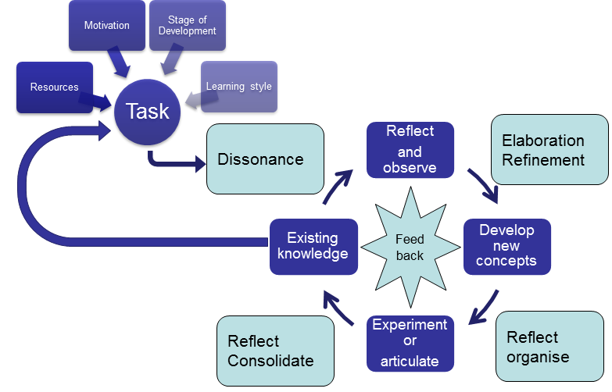
How people learn
Taylor and Hamdy 2013

Slide 3
Feedback is important

Slide 4
The role of the mentor
Bordieu
becoming
Bernstein
boundaries
Land
community
Wenger

Slide 5
Think-Pair-Share
Becoming
Boundaries
Community
What would you find helpful?
How would you help in the processes?
How would you know that what you did worked?

